Slide 1

3D Modeling
Tutor : Liyan Chen
Email: chenliyan@xmu.edu.cn

Slide 2
Chapter 8
Lighting

Slide 3

1. Basic Knowledge of Lighting
In reality, the light is reflected, the ability to reflect light depends on the material reflection objects. But the truth does not exist in the computer, all we need to simulate.
We can use any MAYA lights to create the real light effect, including the reflected light

Slide 4
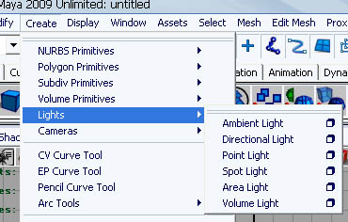
2. Lighting system

Slide 5
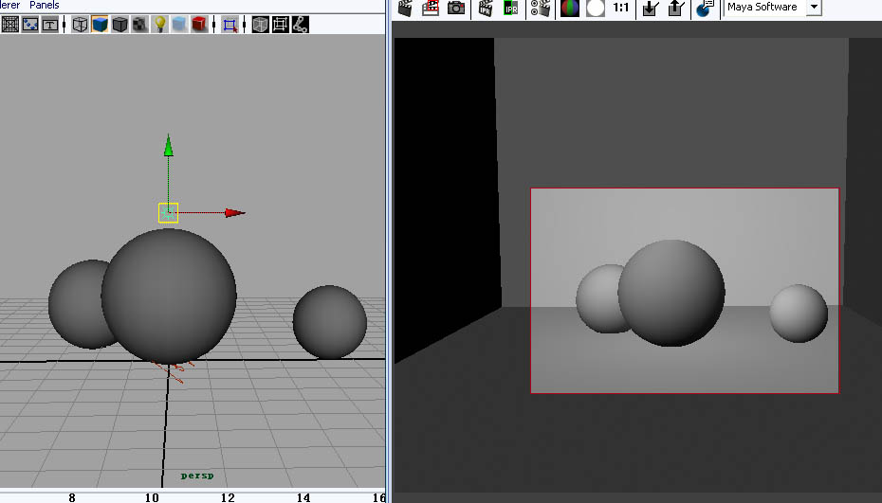
Ambient Light

Slide 6
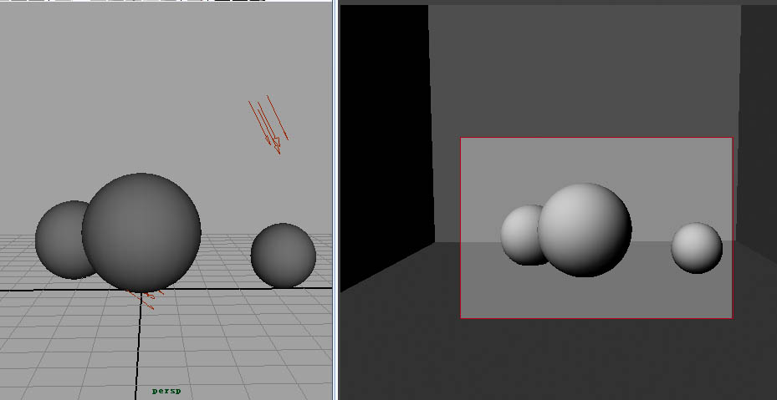
Directional Light

Slide 7
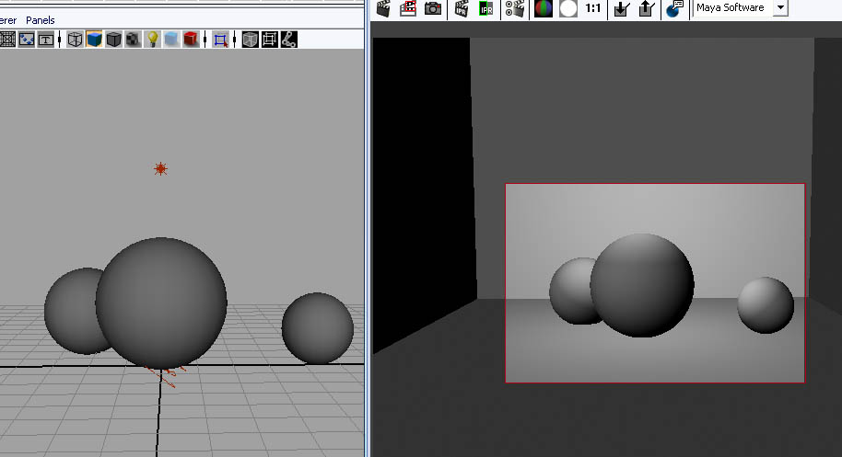
Point Light

Slide 8
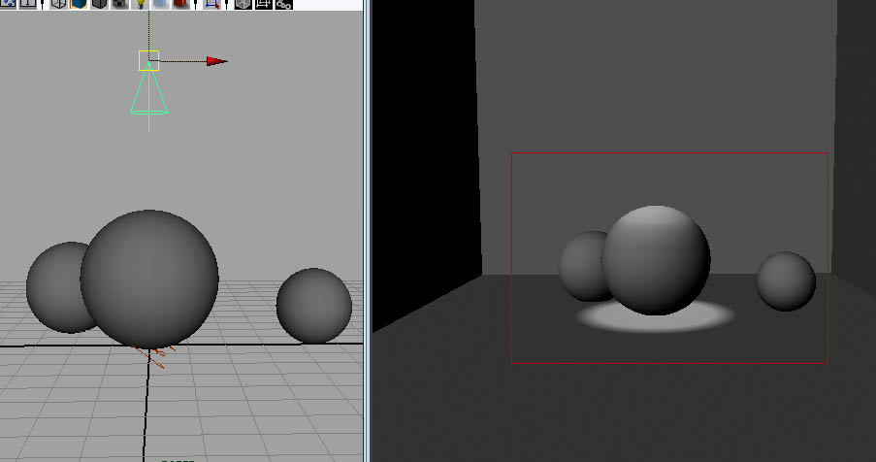
Spot Light

Slide 9
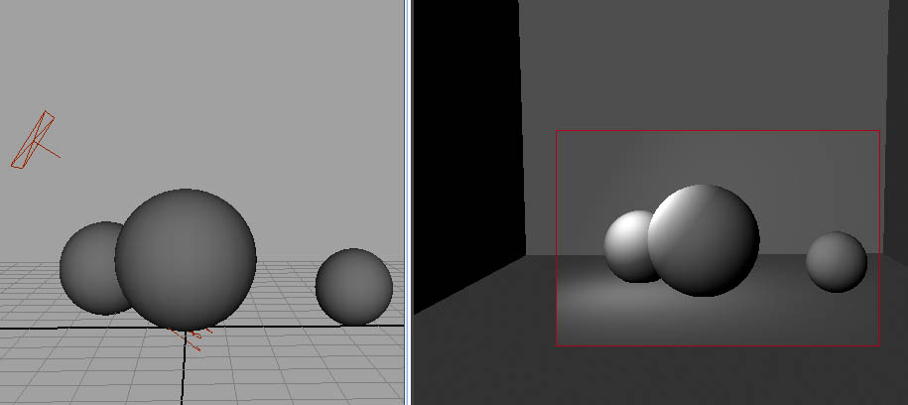
Area Light

Slide 10
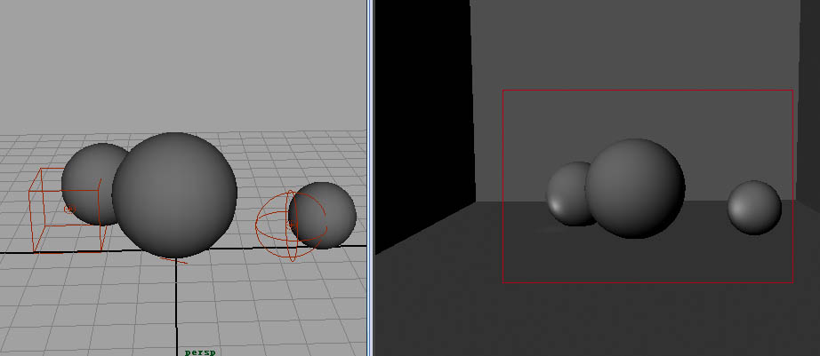
Volume Light

Slide 11
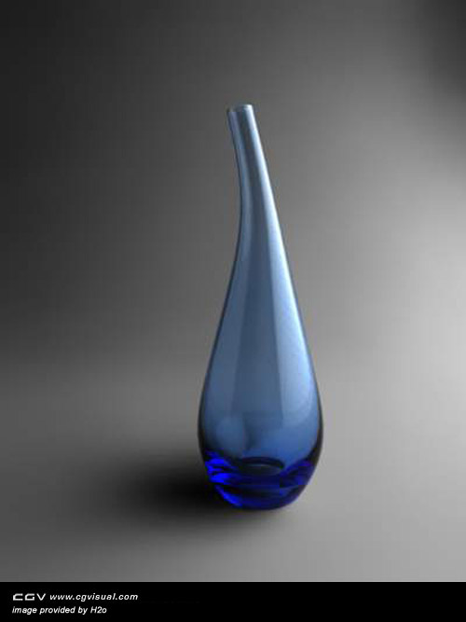
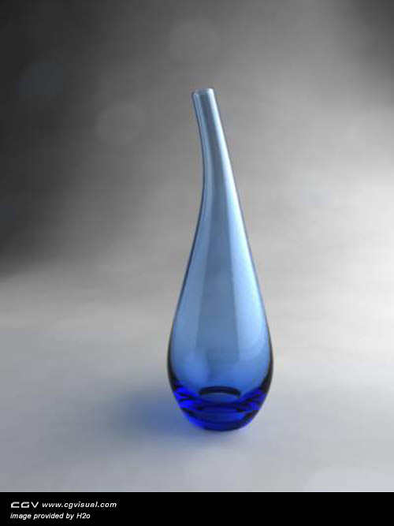
shadow
MAYA provides two shadows: dmap shadow and light track shadow.

Slide 12
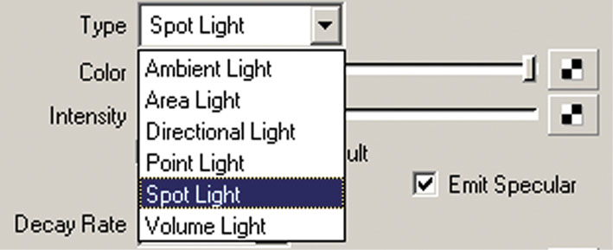
3. Light attribute
Type:

Slide 13
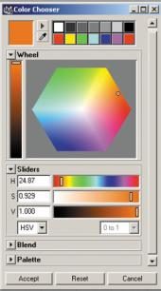
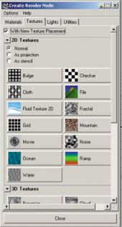
Color:

Slide 14
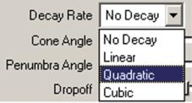

Intensity :
Decay Rate：

Slide 15
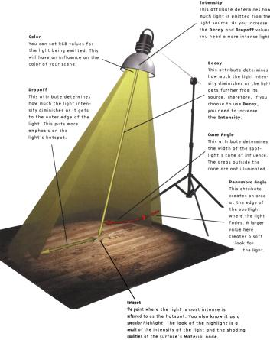
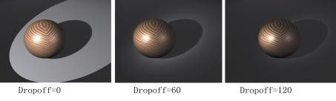
Cone Angle
Penumbra Angle
Drop Off

Slide 16
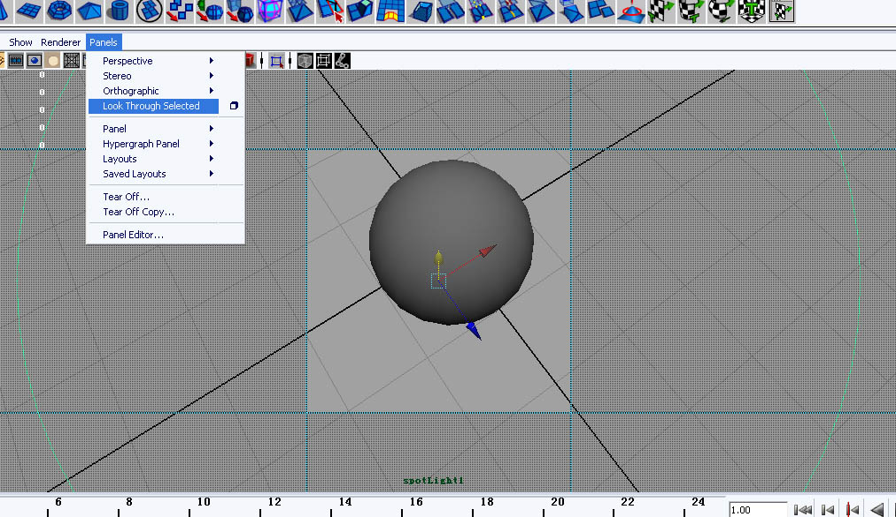
4. Usage Methods of Light

Slide 17
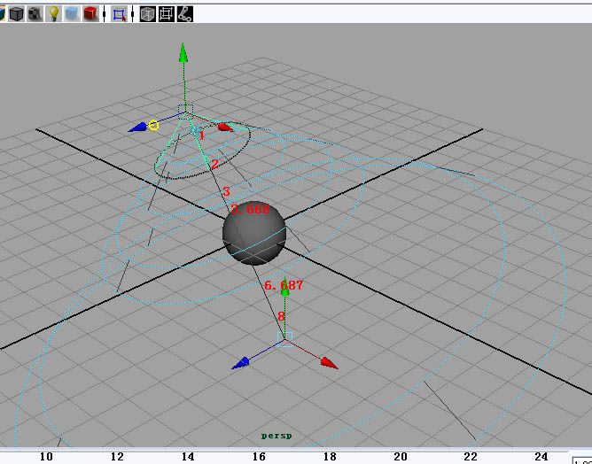
使用操纵器控制灯光(T)

Slide 18
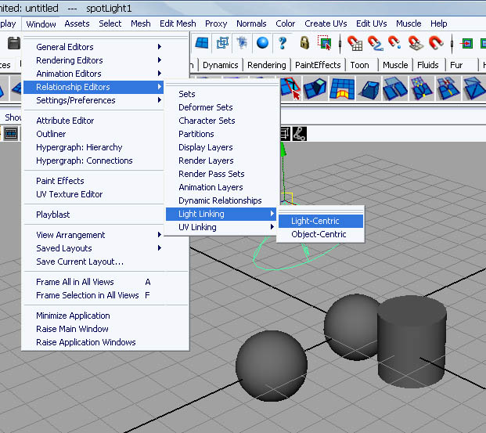
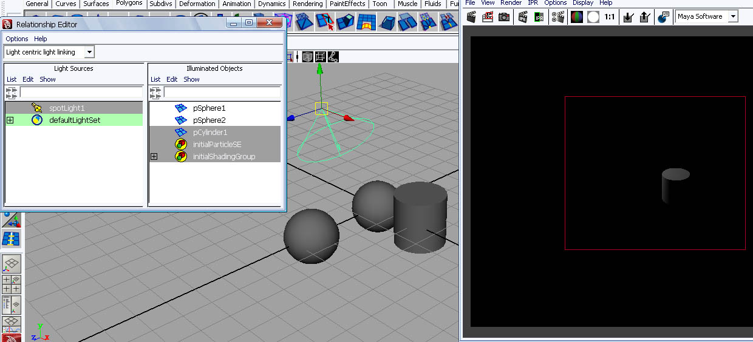

Slide 19
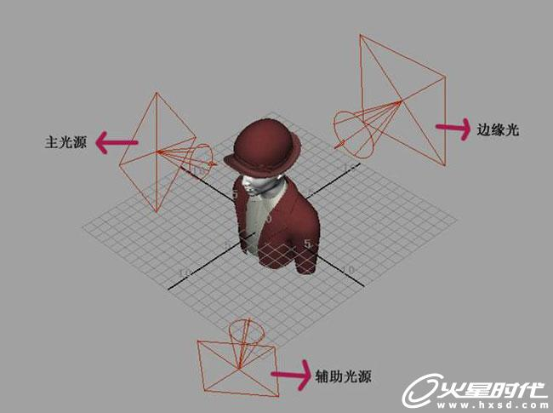
5. lighting arrangement
Three point lighting

Slide 20
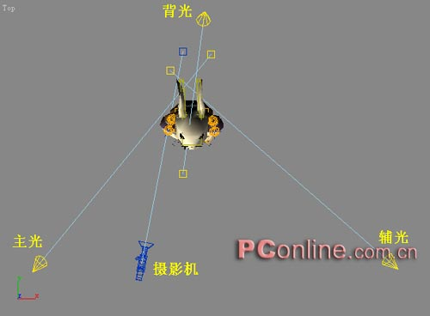
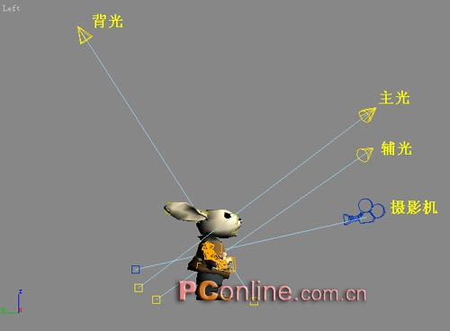

Slide 21
